Slide 1




MINI PROJECT Chethan M – PES2201800331 Anirudh R – PES2201800061 Charan Reddy – PES2201800483
LINEAR ALGEBRA

Slide 2
TOPIC:
FACE RECOGNITION USING PRINCIPAL COMPONENT ANALYSIS

Slide 3
CONCEPTS USED
1
Principal Component Analysis [PCA]
2
Eigen Faces

Slide 4
Principal Component Analysis [PCA]
PCA is a mathematical procedure that converts a set of values of M correlated variables into a set of values of K correlated variables (K<=M)

Slide 5
PCA is a method that brings together:
A measure of how each variable is associated with one another. (Covariance matrix.)
The directions in which our data are dispersed. (Eigenvectors.)
The relative importance of these different directions. (Eigenvalues.)

Slide 6
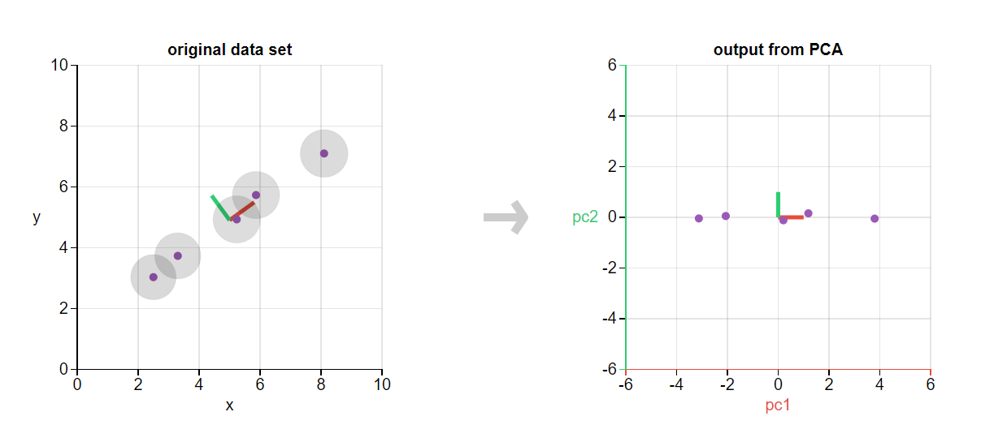
PRINCIPAL COMPONENT ANALYSIS

Slide 7
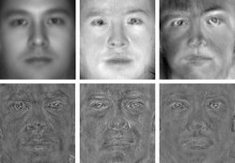
EIGENFACES

Slide 8
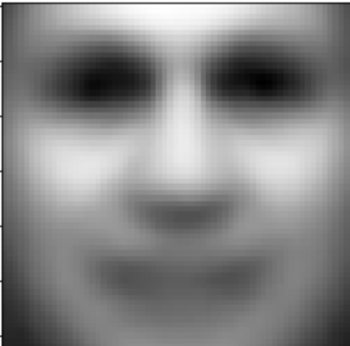
EIGEN FACES FOR GHOSTS
EVEN GHOSTS ARE IDENTIFIED USING EIGENFACES

Slide 9
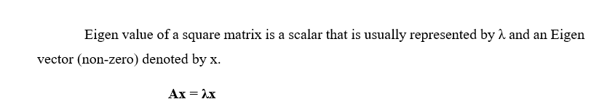
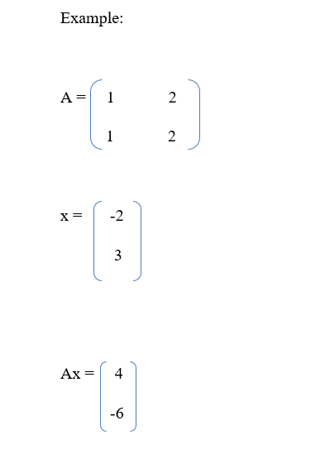
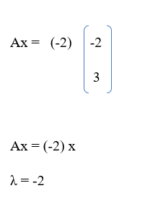
EIGEN VECTORS

Slide 10
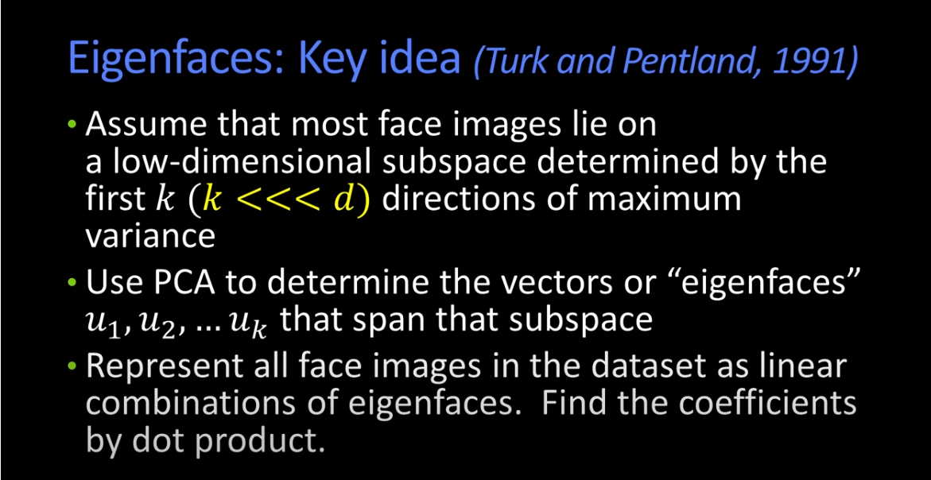

Slide 11
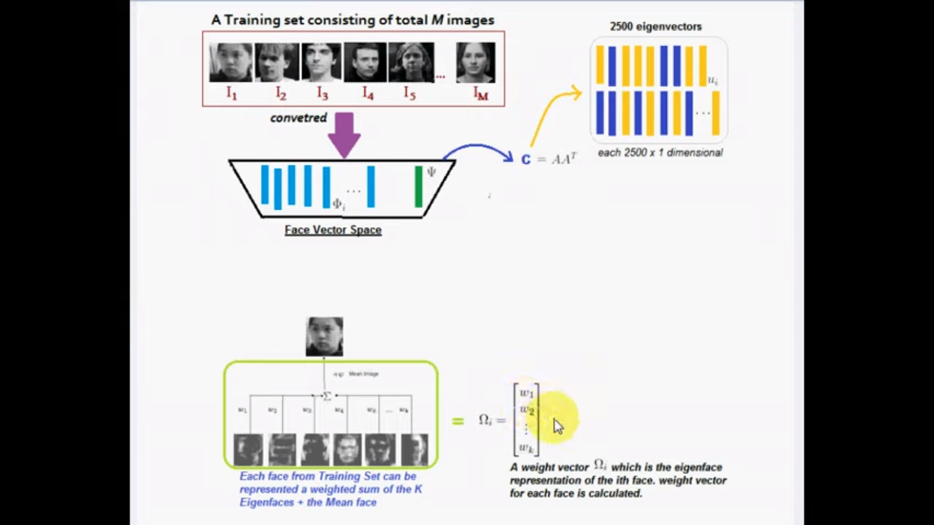

Slide 12
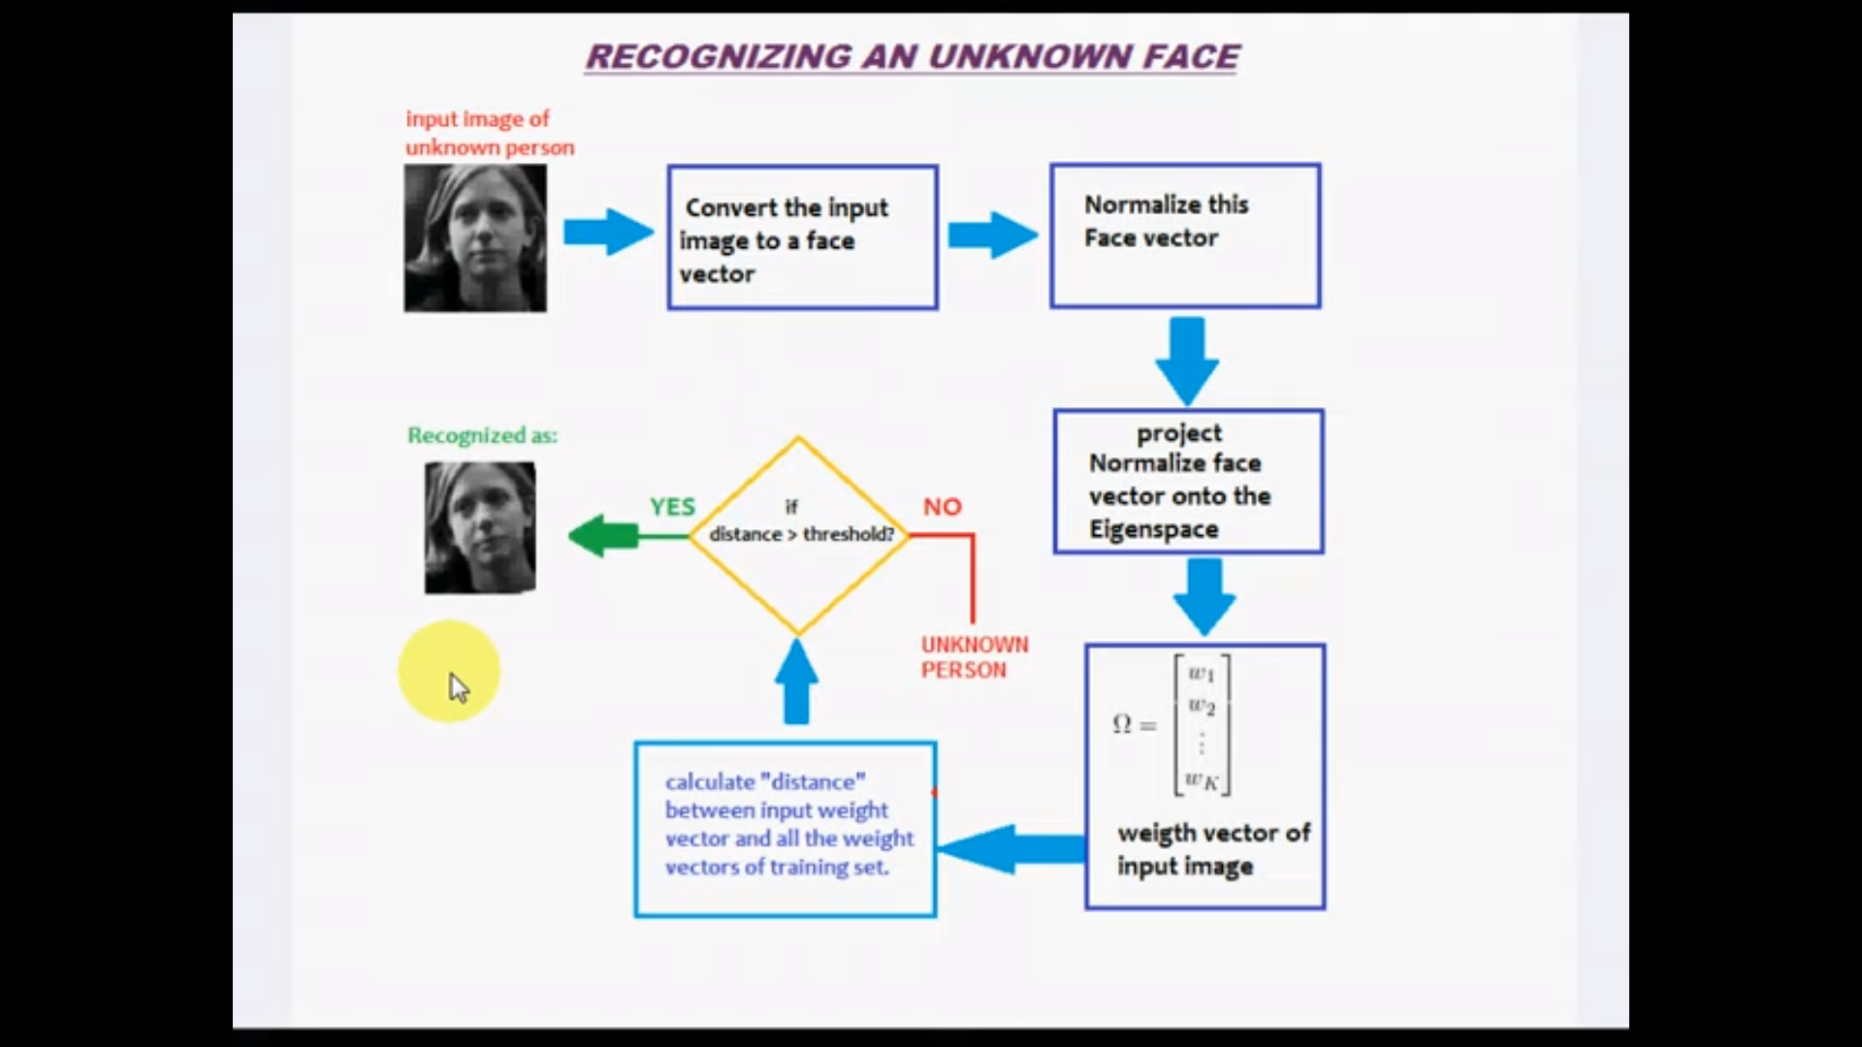

Slide 13
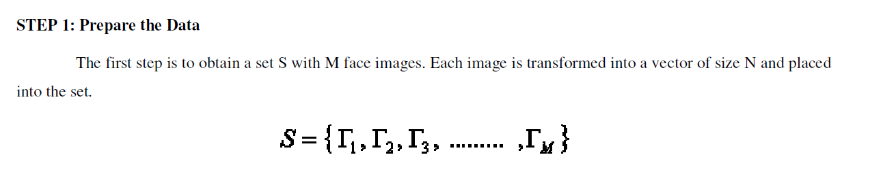
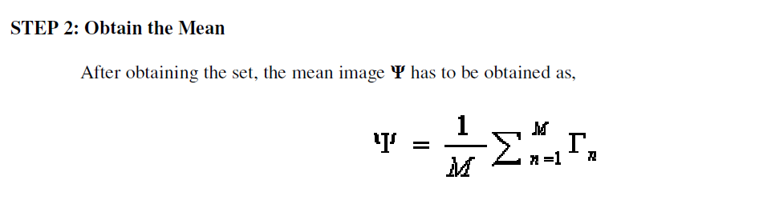
Procedure

Slide 14
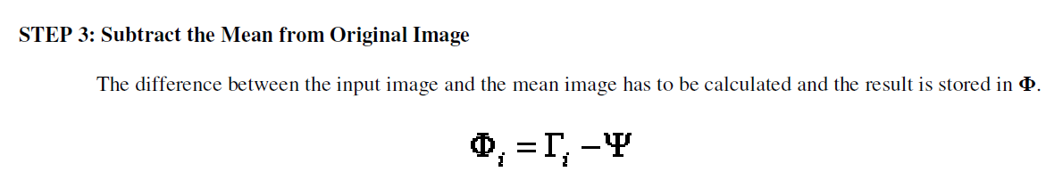
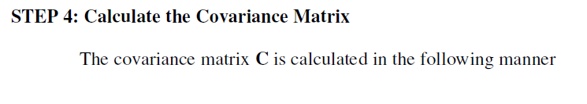
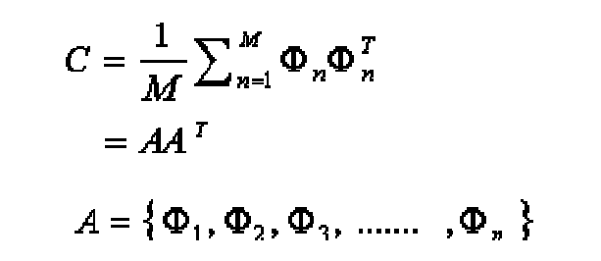

Slide 15
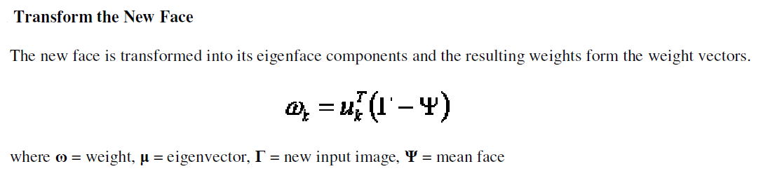
RECOGNITION PHASE

Slide 16
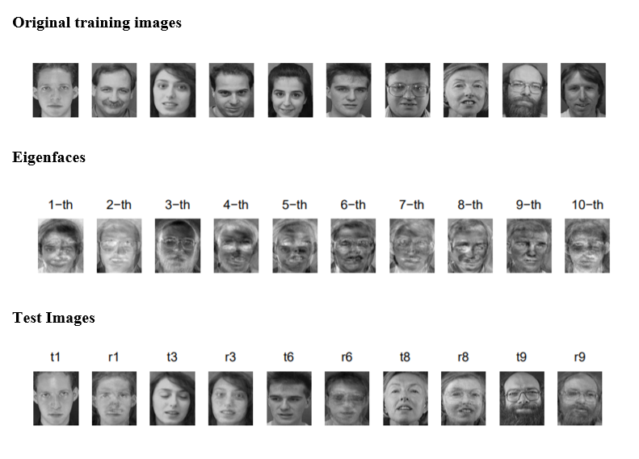

Slide 17
THANK YOU !
Notes:
You can use this slide as your opening or closing slide. Should you choose to use it as a closing, make sure you review the main points of your presentation. One creative way to do that is by adding animations to the various graphics on a slide. This slide has 4 different graphics, and, when you view the slideshow, you will see that you can click to reveal the next graphic. Similarly, as you review the main topics in your presentation, you may want each point to show up when you are addressing that topic.
Add animation to images and graphics:
Select your image or graphic.
Click on the Animations tab.
Choose from the options. The animation for this slide is “Split”. The drop-down menu in the Animation section gives even more animations you can use.
If you have multiple graphics or images, you will see a number appear next to it that notes the order of the animations.
Note: You will want to choose the animations carefully. You do not want to make your audience dizzy from your presentation.

